Slide 1
The Great Depression
SSUSH17 – Analyze the causes and consequences of the Great Depression.
Describe the causes, including overproduction, underconsumption, and stock market speculation that
led to the stock market crash of 1929 and the Great Depression.
b. Explain factors (include over-farming and climate) that led to the Dust Bowl and the resulting
movement and migration west.
c. Explain the social and political impact of widespread unemployment that resulted in developments
such as Hoovervilles.

Slide 2
Causes of the Great Depression
Industrial Overproduction
- Industries increased their productive capacity to produce and sell more goods.
- European countries could not buy goods due to their financial struggles.
Consumer Overspending
-Americans went on a spending spree, developing a national consumer market. After the stock market crash of 1929 consumers quit spending except on necessities creating a surplus of goods in the marketplace, resulting in under-consumption.
Disparity of Wealth
-While many Americans did prosper during the 1920s some didn’t
-Farmers were having difficulty, other employment sectors were failing.
The richest 1% of the American population owned 40% of U.S. wealth.
Bank Failure- 9000 banks failed during the 1930s

Slide 3
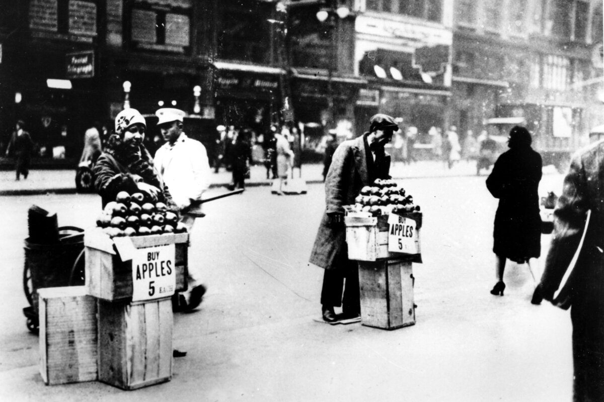

Slide 4
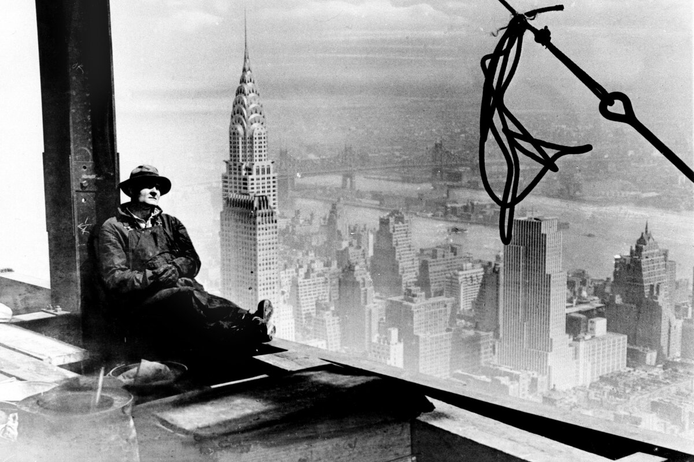

Slide 5
Stock Market Crash of 1929
Investors increase their wealth through speculation through the stock market.
Companies offer more shares of stock to obtain capital for expansion.
Growing demand for stock translates into growing value of stock shares.
Buyers were allowed to borrow money to purchase as little as ten percent down.
Stock prices fell, stock buyers were in debt.
Speculators sell off stock at large numbers at the same time.

Slide 6
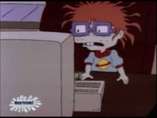

Slide 7
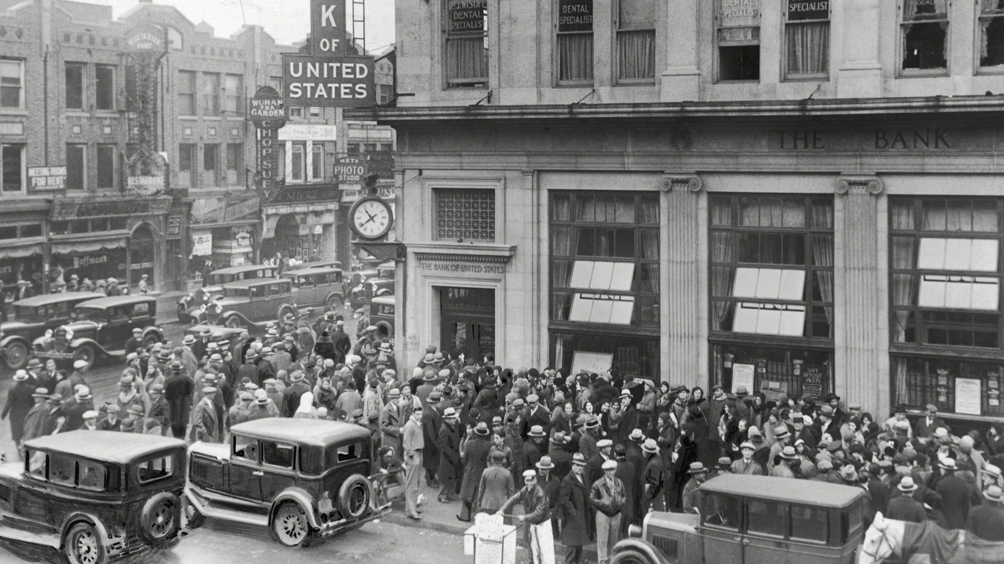

Slide 8
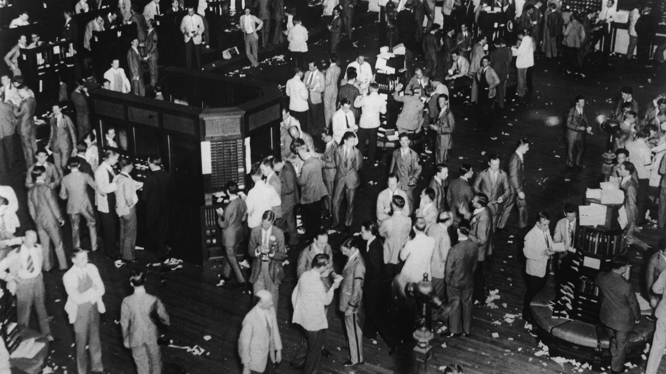

Slide 9
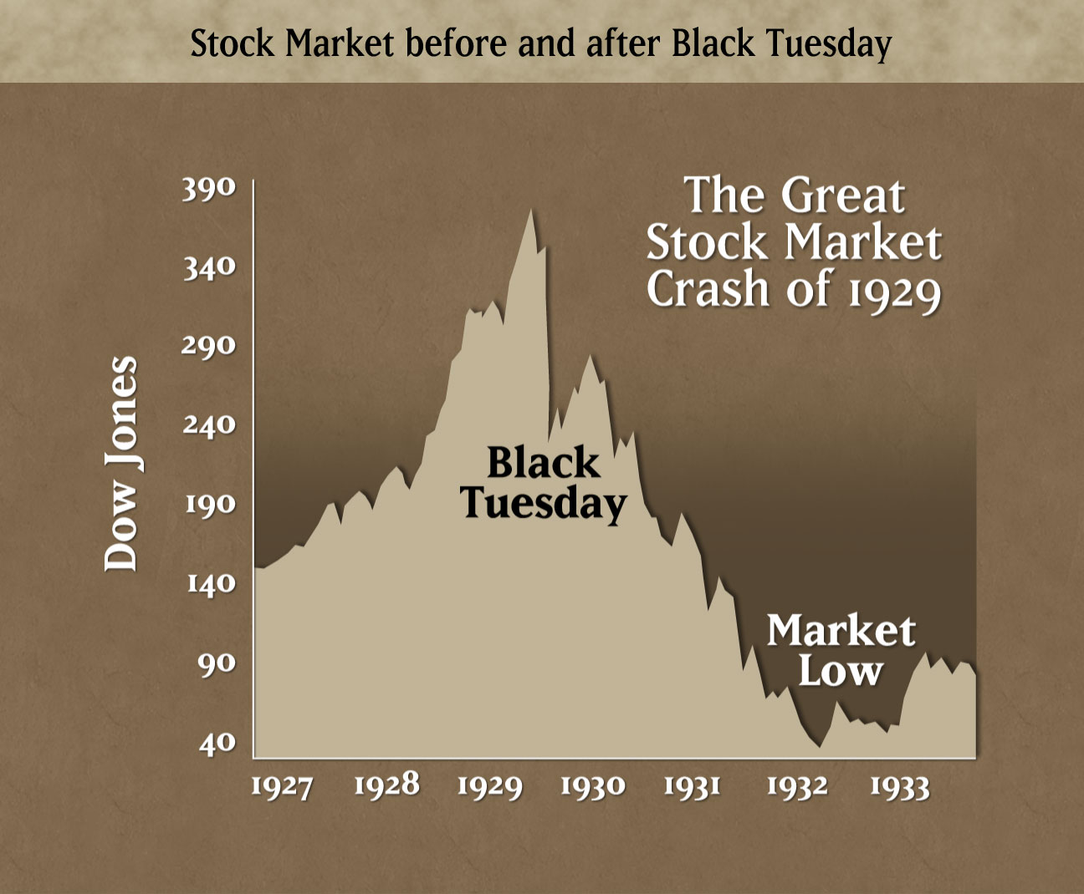

Slide 10
Unemployment
Two million homeless people migrated across the country.
Twenty five percent of the labor force was unemployed in the United States.
Women and Minorities were affected the most.
Women were fired and replace by Men.
Black workers were replaced by White workers.
Men and teenagers left home in search for jobs.

Slide 11
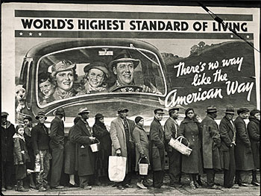

Slide 12
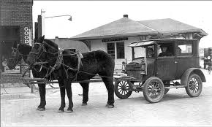

Slide 13
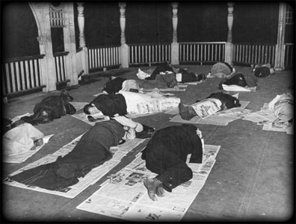

Slide 14
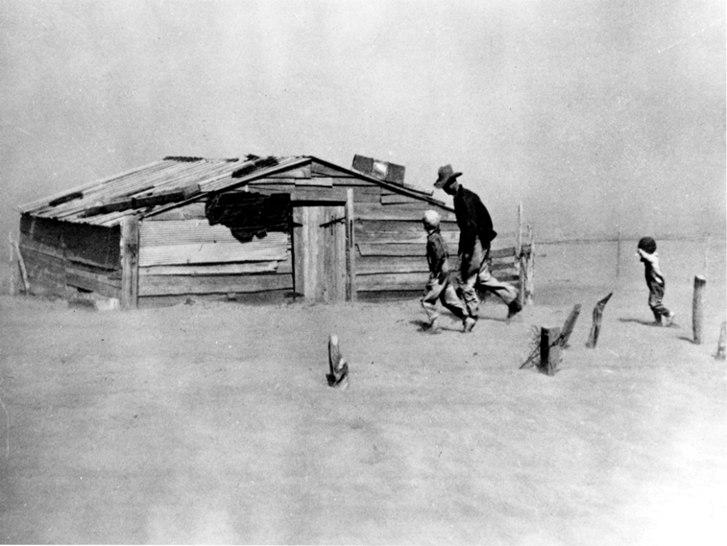
The Dust Bowl
Southern plains of the United States
Farmers planted thousand of acres of land
1931 region entered a dry cycle.
Worst drought in American history.
Farmers continued to plant despite crop failure.
Deep plowing killed the praire grassed holding top soil
Wind blows top soil away.
Clouds formed thousands of feet high.

Slide 15
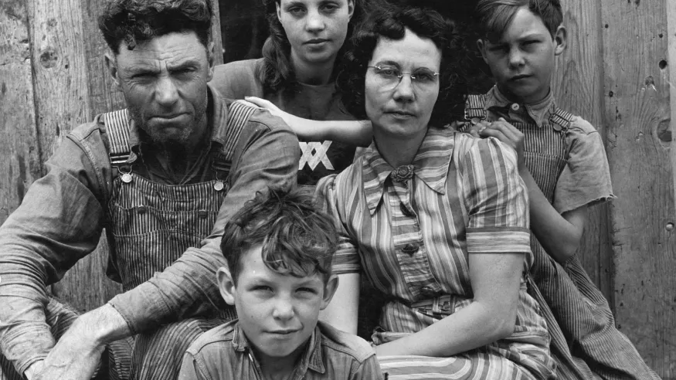

Slide 16
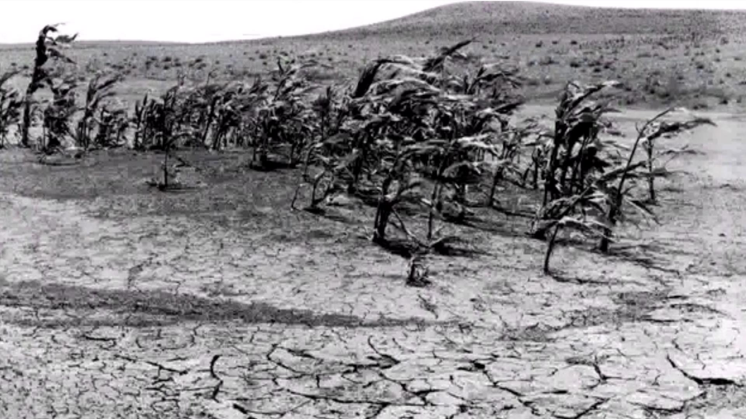

Slide 17
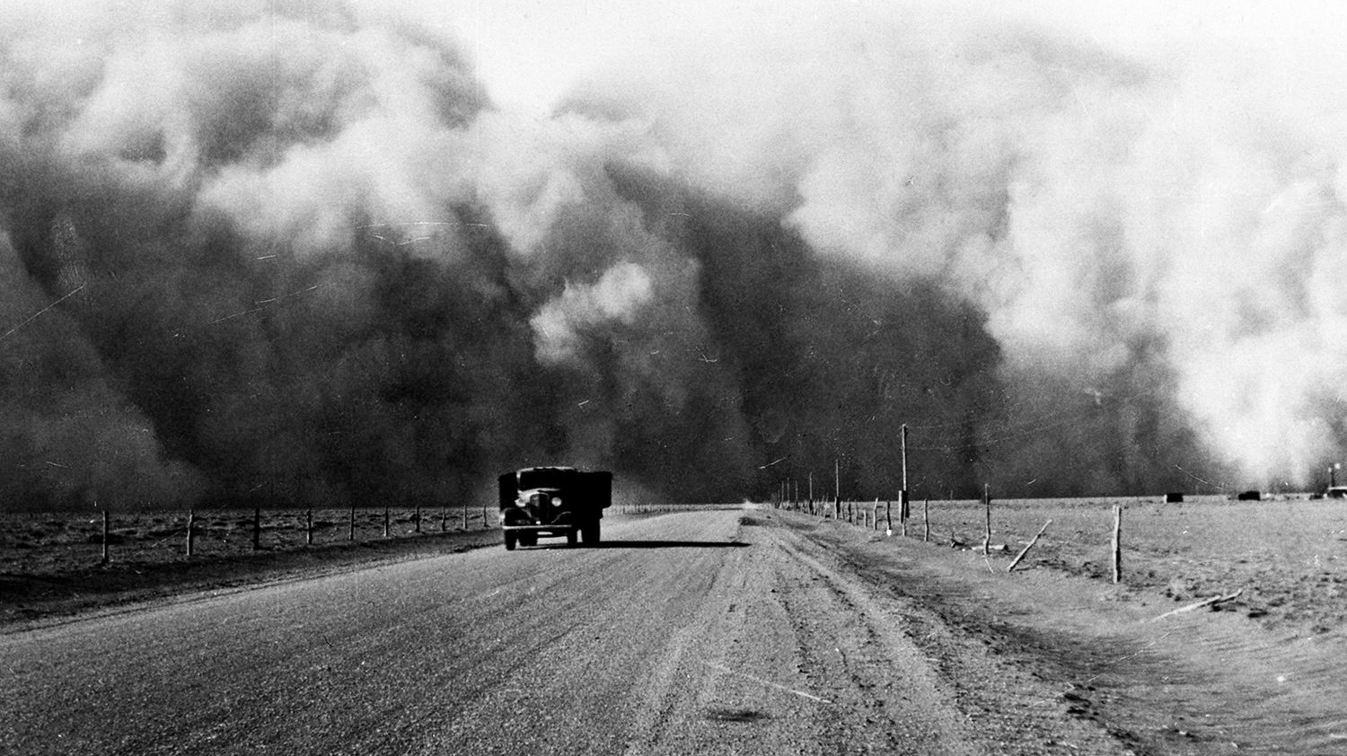

Slide 18
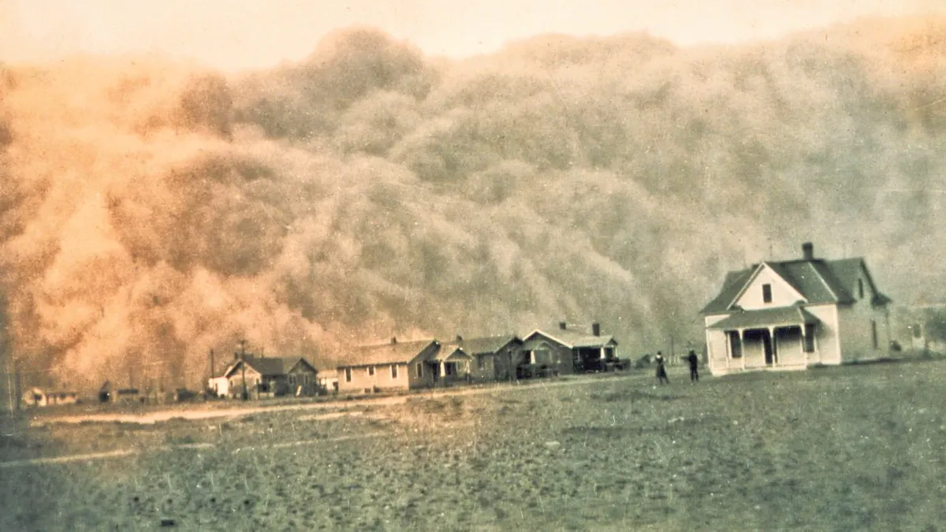

Slide 19
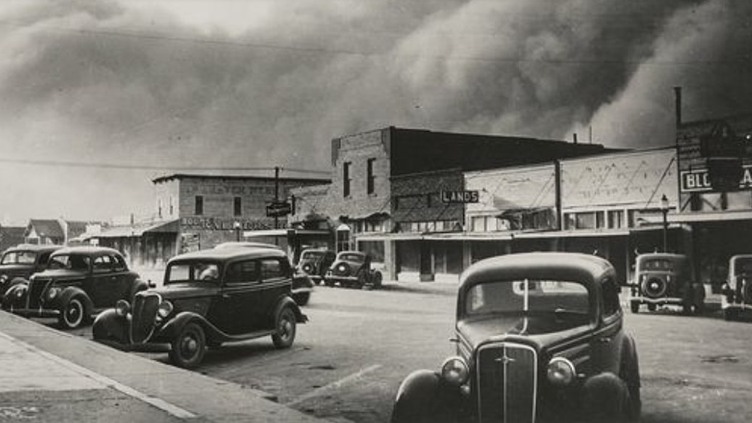

Slide 20
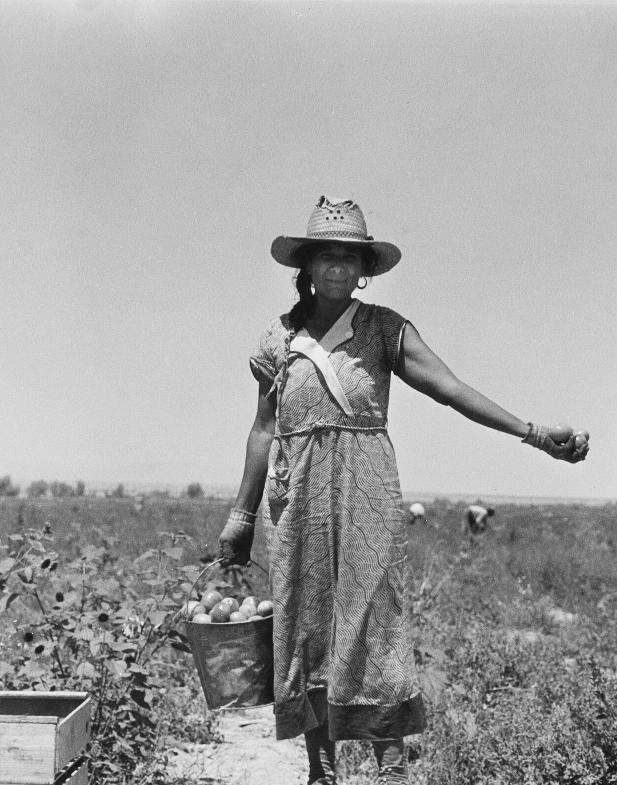
The Dust Bowl (western migration)
Large groups of families are leaving states like Texas, Oklahoma, and Colorado.
Settled in central California.
Okies
Migrant farm workers, who worked vegetable, fruit, and cotton harvest through the West Coast.
Dust Bowl ended in 1938- Passed the Soil Conservation Act, encouraging better plowing methods.

Slide 21
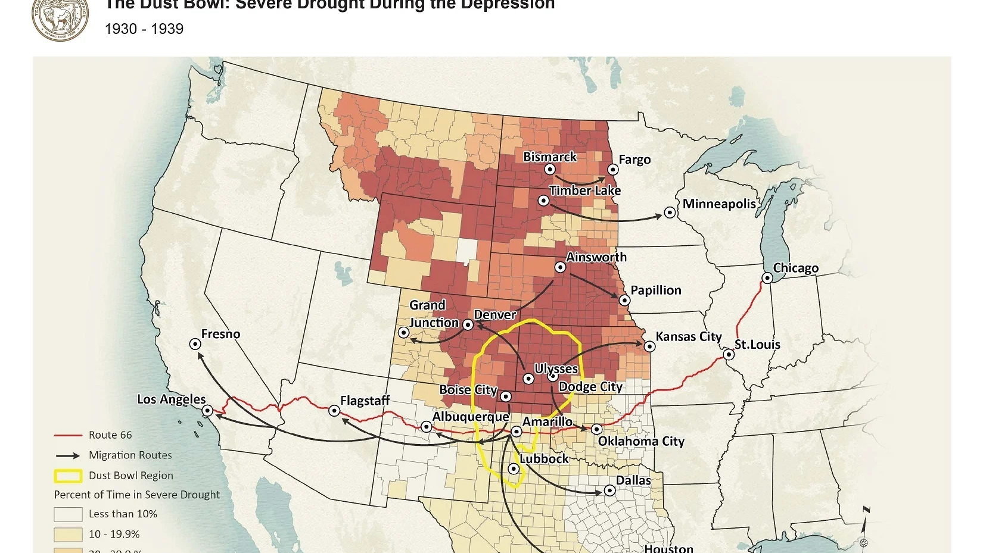

Slide 22
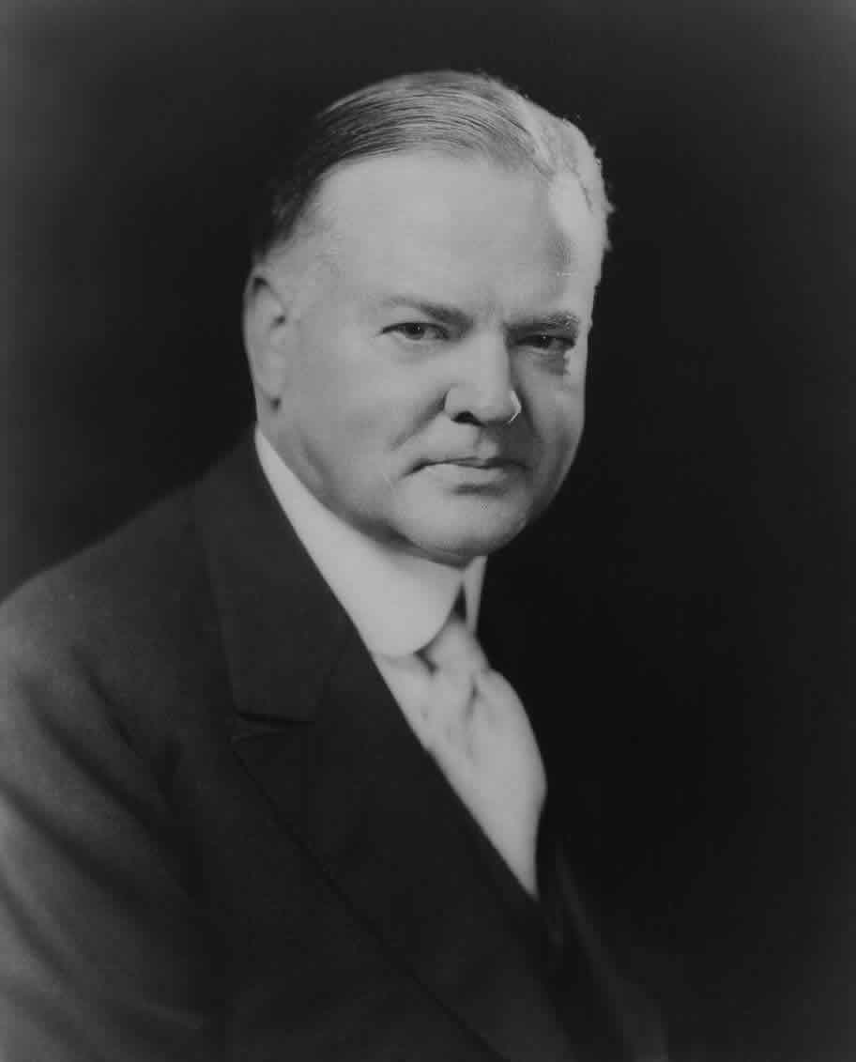

Slide 23
Hoover’s negative impact on the Great Depression
Hoover tried to attempt to diminish the impact of the Great Depression.
Created relief programs
Attempt to ask Federal Government to guarantee home loans
His programs reach the public too late.
Homeless families, lacking shelter used cardboard and crates to create encampments called Hoovervilles.
Named after President Herbert Hoover and his handling of the economic crisis.

Slide 24
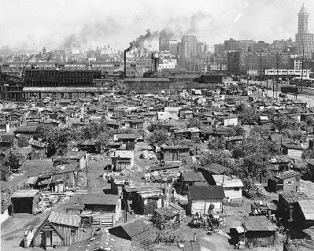

Slide 25
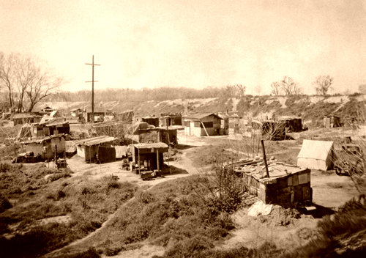

Slide 26
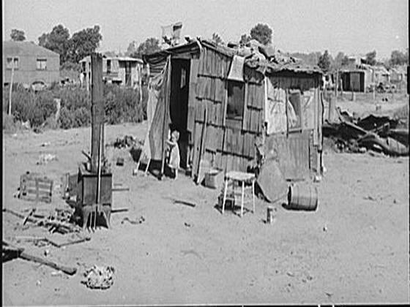

Slide 27
Election of 1932
Hoover ran for re-election against Franklin D. Roosevelt.
Roosevelt blamed Hoover for the Great Depression.
FDR won the election of 1932.
Roosevelt issued the New Deal.
Provided relief to people struggling during the economic crisis.

Slide 28
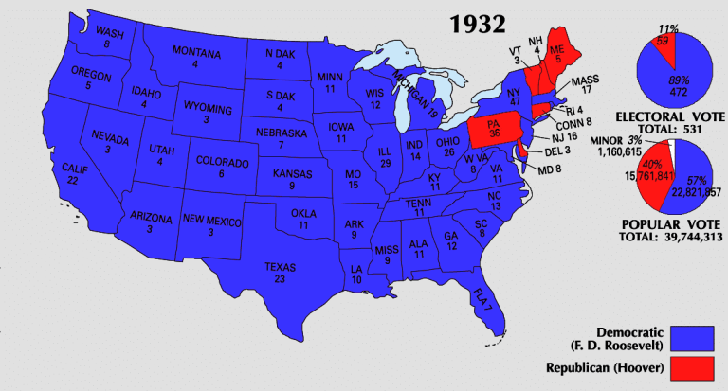
Election of 1832

Slide 29
The new deal
SSUSH18 – Evaluate Franklin D. Roosevelt’s New Deal as a response to the Great Depression and compare how governmental programs aided those in need.
Describe Roosevelt’s attempts at relief, recovery, and reform reflected in various New Deal programs.
Explain the passage of the Social Security Act as a part of the second New Deal.
Analyze political challenges to Roosevelt’s leadership and New Deal programs.
Examine how Eleanor Roosevelt changed the role of the First Lady including development of New Deal programs to aid those in need.

Slide 30
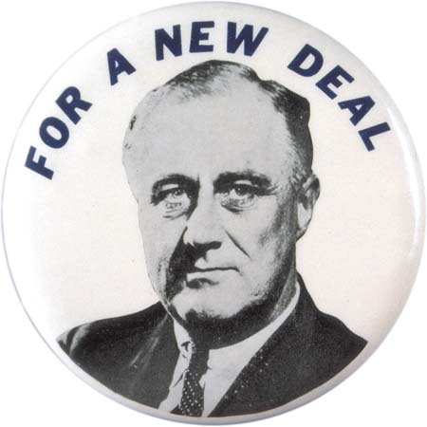
First one hundred days in office
Roosevelt issued the New Deal.
Provided relief to people struggling during the economic crisis
National bank holiday- Roosevelt issue that banks will temporaliy close
Roosevelt signed an executive order to close all banks.
Fireside chats- radio broadcast messages delivered by President Roosevelt

Slide 31
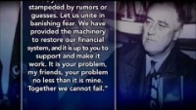
2125
0

Slide 32
Alphabet Organizations created
Agricultural Adjustment Act (AAA)
  Restore agricultural prosperity during the Great Depression.
  Curtailing farm production, reducing export surpluses, and raising prices.
  Repair prices of goods paid to farmer to the purchasing power to that before the Depression
Tennessee Valley Authority (TVA)
  Hired thousands of workers to fix & build dams
  Flood control & hydroelectric power
  Help the poorest areas

Slide 33
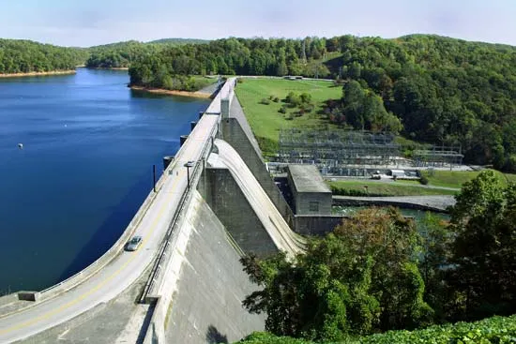

Slide 34
Alphabet organizations
Civilian Conservation Corps (CCC)
Most popular program out of the New Deal.
  Single men—18-25
  Build roads, parks, plant trees
  Help the environment
  (paid $30/month--$25 sent back home)
  Dissolved in 1942
  FDIC- Help restore public confidence in banks. Provides insurance on bank accounts.
(FERA, PWA, CWA, WPA, NYA, EBRA, NRA, SEC, FDC, REA, HOLC, FHA, USHA)

Slide 35
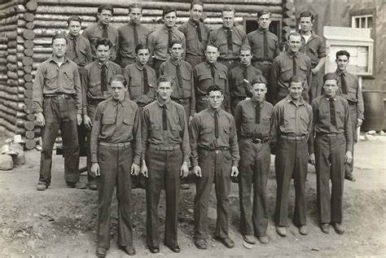


Slide 36
Social Security Act/ Second New Deal
Roosevelt believe that a Second New Deal is needed
Some groups weren’t included in the First New deal
Senior Citizens
The Social security Act of 1935 was passed.
Provides Old age pension, unemployment insurance and aid to the disabled.

Slide 37
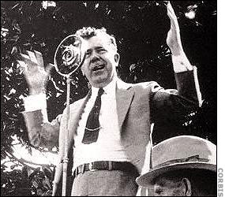
New Deal Criticism
Political spectrums from both sides attacked Roosevelt resulted in the New Deal.
Conservative believe FDR went too far; Liberals believe he didn’t go far enough.
Huey Long, governor of Louisiana, challenged FDR for presidency.
Didn’t believe that the New Deal went far enough.
Proposed Share our wealth program.
Assassinated in 1935

Slide 38
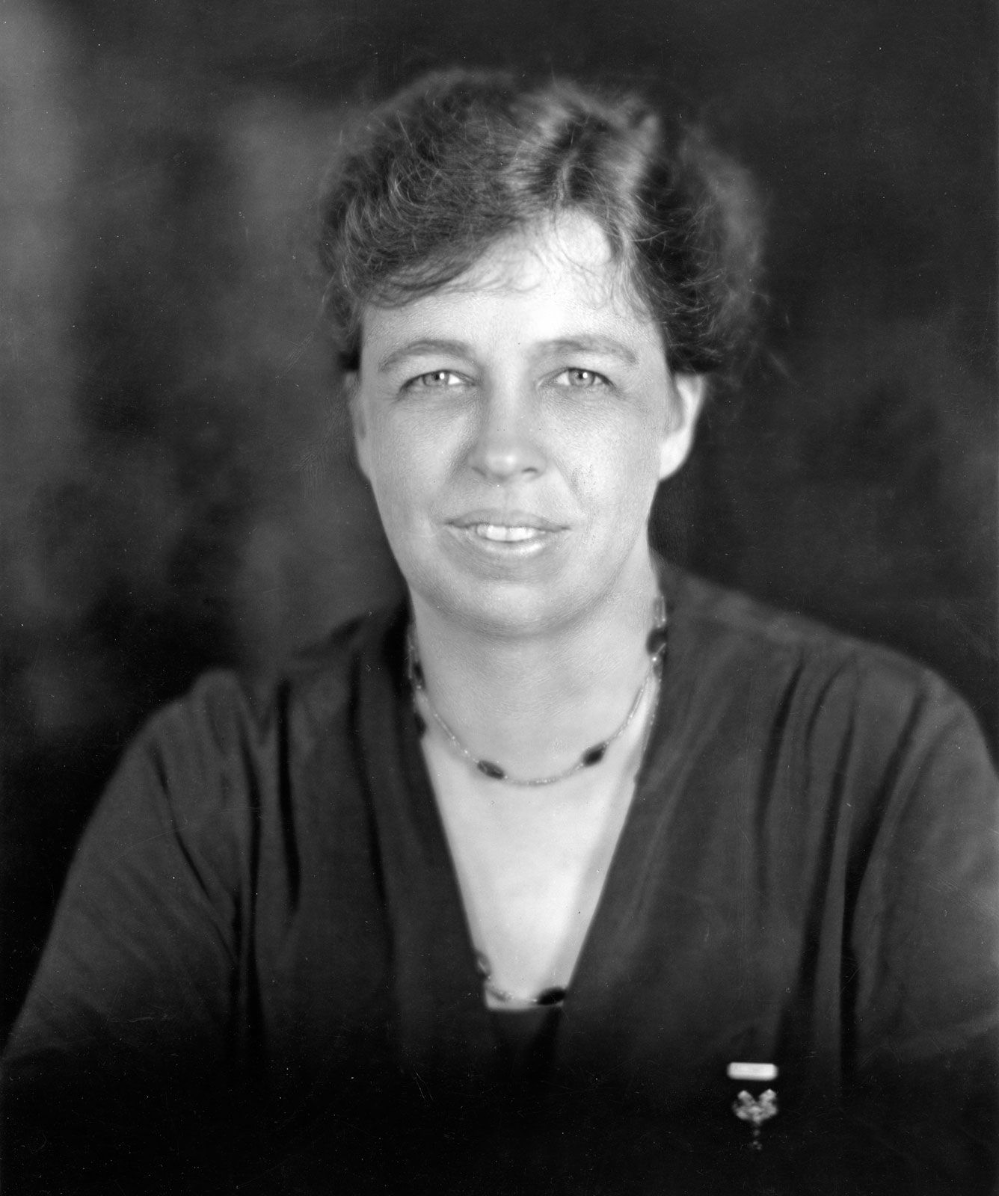
Eleanor Roosevelt
Very influential
Interested in humanitarian causes and progress
Travel across the U.S to social conditions
Convince President to appoint more women to government positions
Known as “First lady of the world”
FDR’s Legs, eyes, and ears.

Slide 39
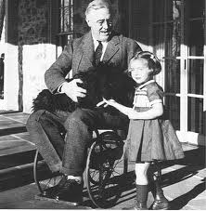
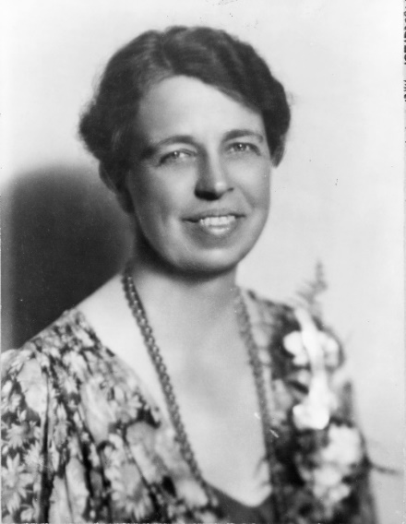
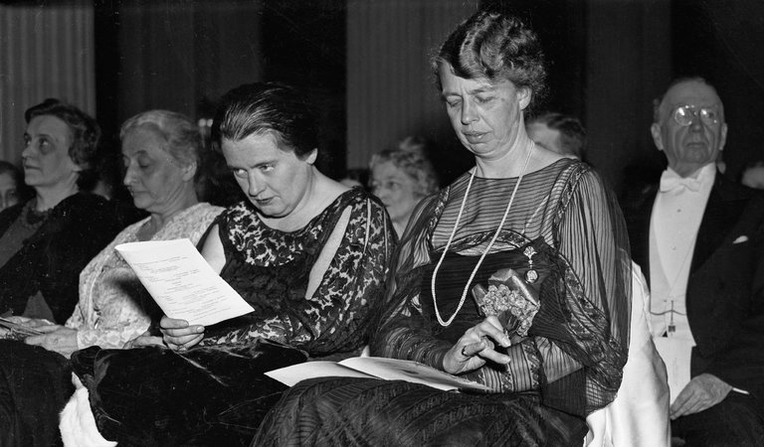

Slide 40
World war ii
SSUSH19 – Examine the origins, major developments, and the domestic impact of World War II,
including the growth of the federal government.
Investigate the origins of U.S. involvement in the war including Lend-lease and the Japanese attack on Pearl
Harbor.
Examine the Pacific Theater including the difficulties the U.S. faced in delivering weapons, food, and
medical supplies to troops, the Battle of Midway, Manhattan Project and the dropping of the atomic bombs.
Examine the European Theater including difficulties the U.S. faced in delivering weapons, food, and
medical supplies to troops, D-Day, and the Fall of Berlin.
Investigate the domestic impact of the war including war mobilization, as indicated by rationing, wartime
conversion, and the role of women and African Americans or Blacks.
Examine Roosevelt’s use of executive powers including the integration of defense industries and the
internment of Japanese-Americans.

Slide 41
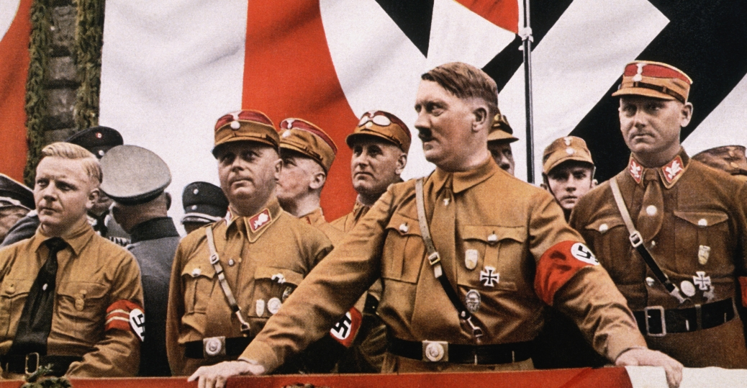

Slide 42
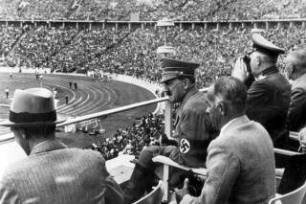

Slide 43
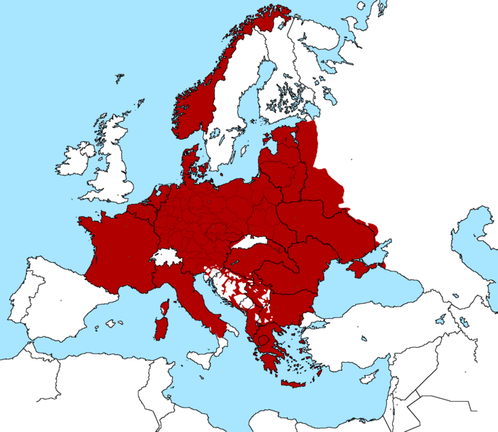

Slide 44
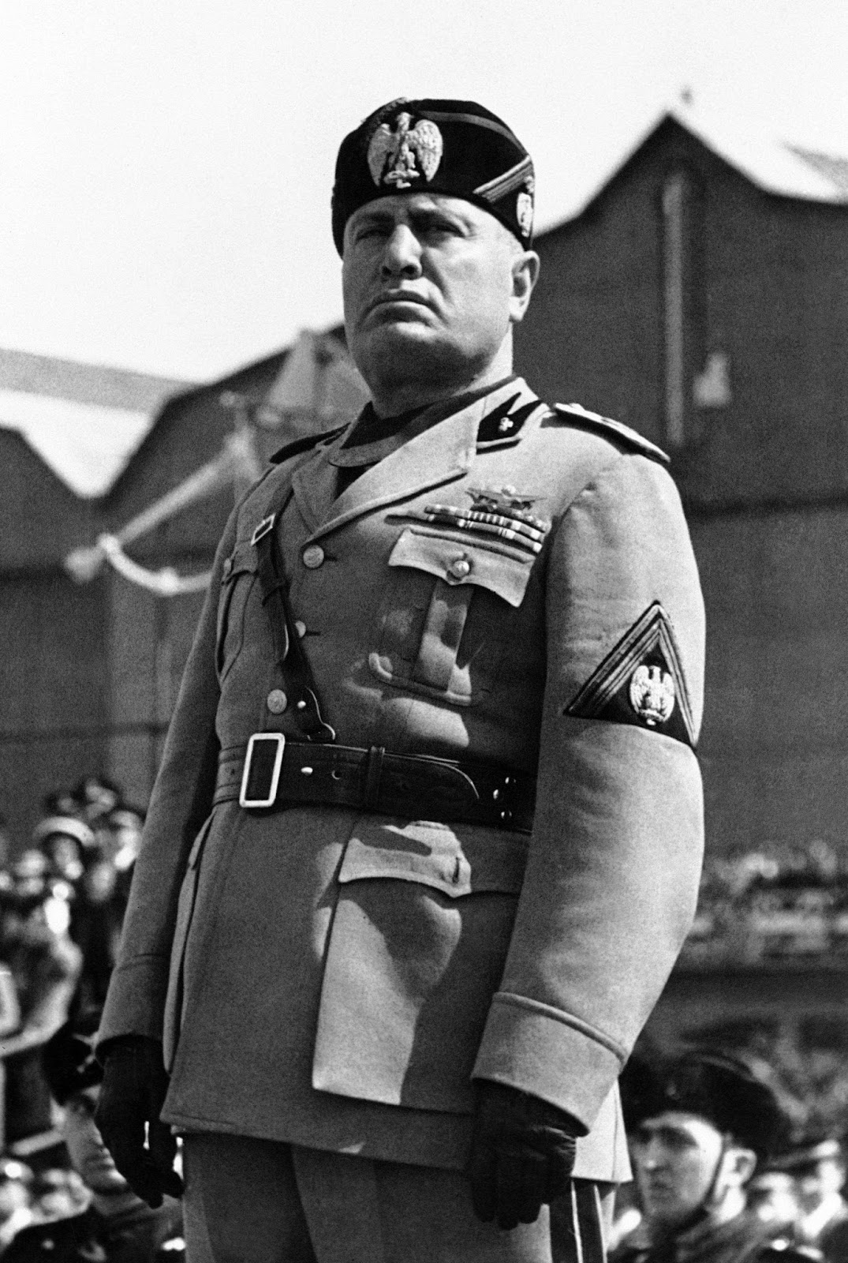
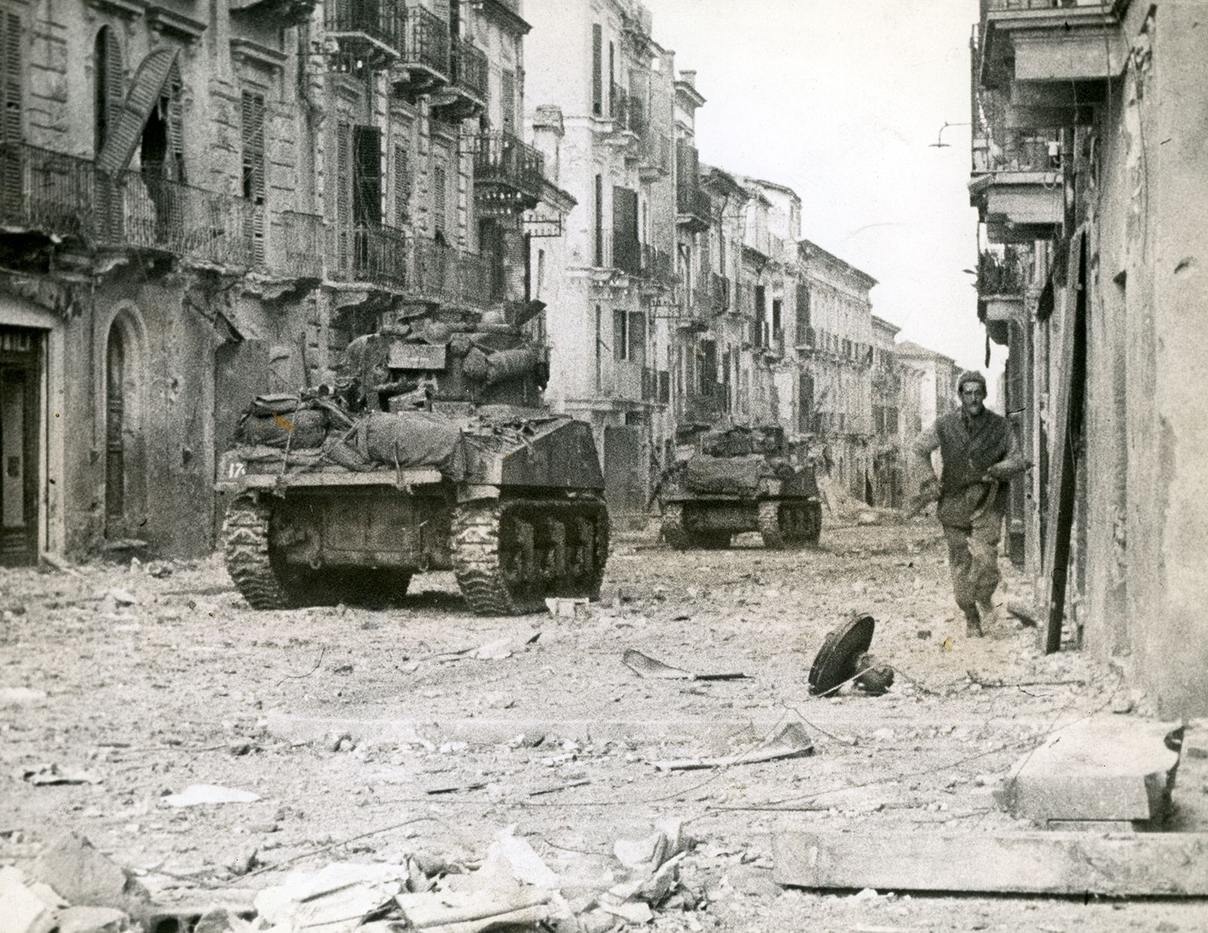

Slide 45
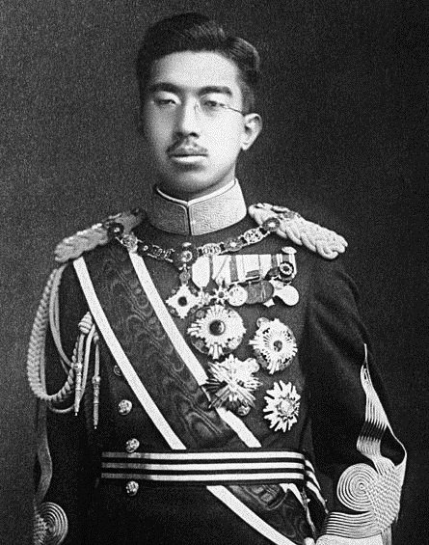
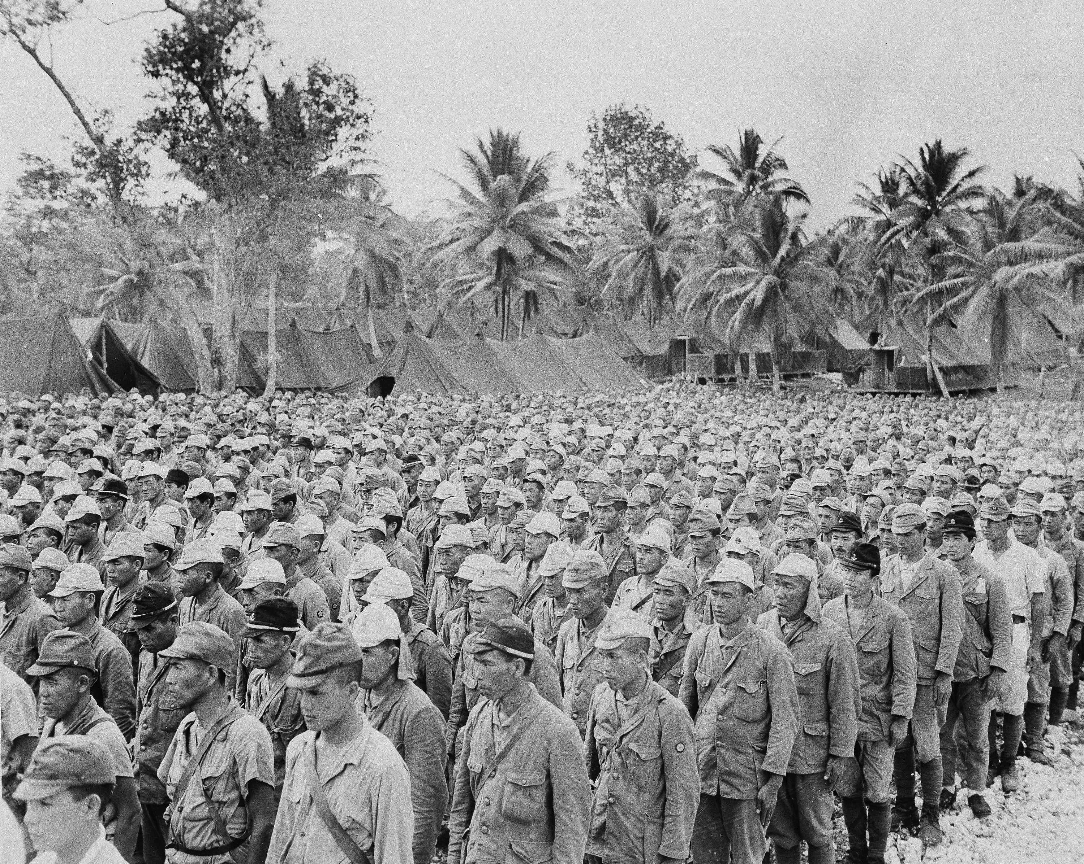

Slide 46
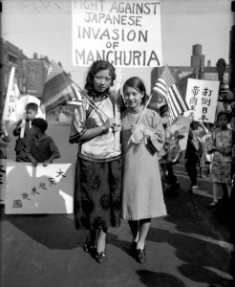
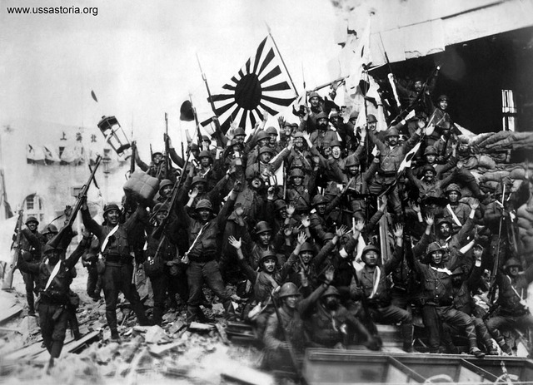

Slide 47
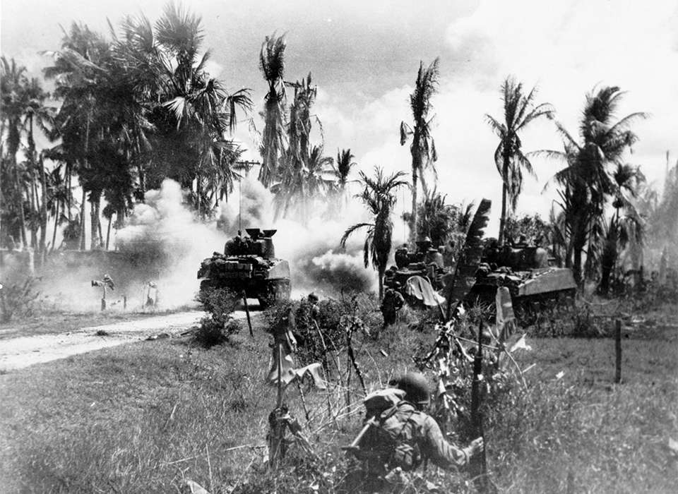

Slide 48
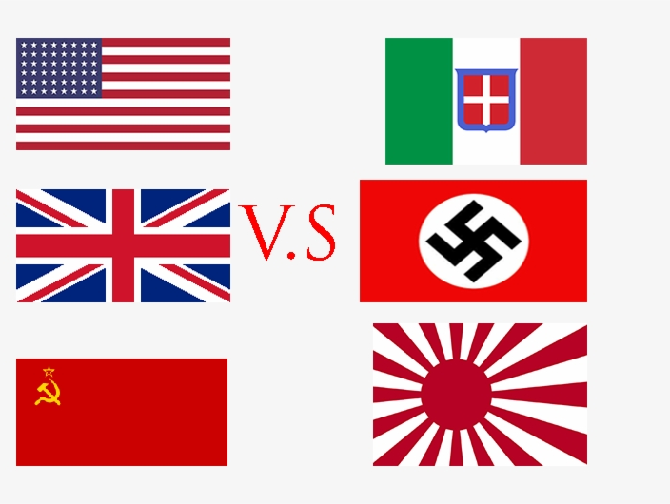
AXIS POWERS VS. ALLIES POWERS
Germany
Italy
Japan
France
Great Britain
United States
Soviet Union (Russia)

Slide 49
Early beginnings of Wwii
The United States was cautious about entering World War II
Danger Spreads across Europe, the rise of Dictators.
Nazi influences started to spread across European countries.
United States remained neutral until 1941
Neutrality acts- prohibited sales of any weapons or materials.

Slide 50
United states involvement
“Cash & Carry”—N Act of 1937
  Assist our allies (GB & F) in case of war—but only for 2 years and no weapons
  Pay cash & transport w/ your ship (not America’s)
    Believed this helped us get into WWI
  Extended(N Act of 1939) in response to Germany invading Poland (WWII beginning)—weapons now ok
Lend lease act- created a pathway for American goods to still support Allies war effort.
Roosevelt provided 1 billion dollars in lend lease aid.

Slide 51
Japan’s goals
Conquer all of Asia.
Germany conquered France and the Netherlands( who had control over countries in Asia)
Japan gained control of French Indochina and threatened the Dutch East Indies, American Philippines, and British Malaysia.
Targeted weaker nations (China & Korea)
U.S angered by Japan’s aggression in China
Lend lease law helps the United States lend money to the Chinese
Japan felt threatened by the United States

Slide 52
Pearl Harbor
Dec 7, 1941
Japanese believe it was necessary to destroy the American pacific fleet.
Want to take over the South Pacific Islands
Launched a surprise attack on the United States Navy harbor base, Pearl Harbor.
2400 Americans were killed
1178 wounded
19 ships were damaged
300 aircraft carriers were destroyed
United States enters World War II

Slide 53
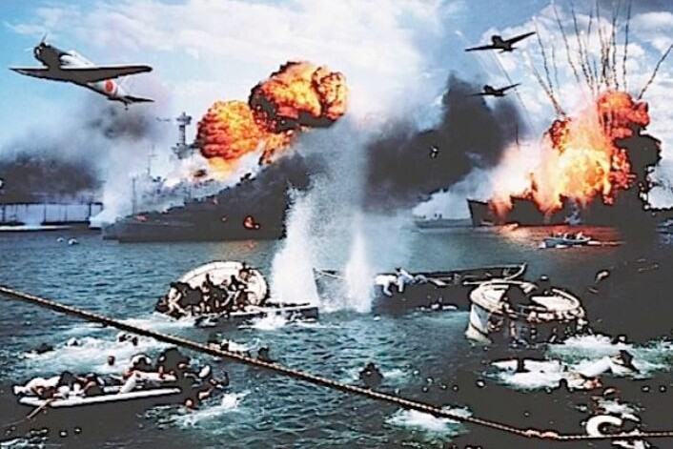

Slide 54
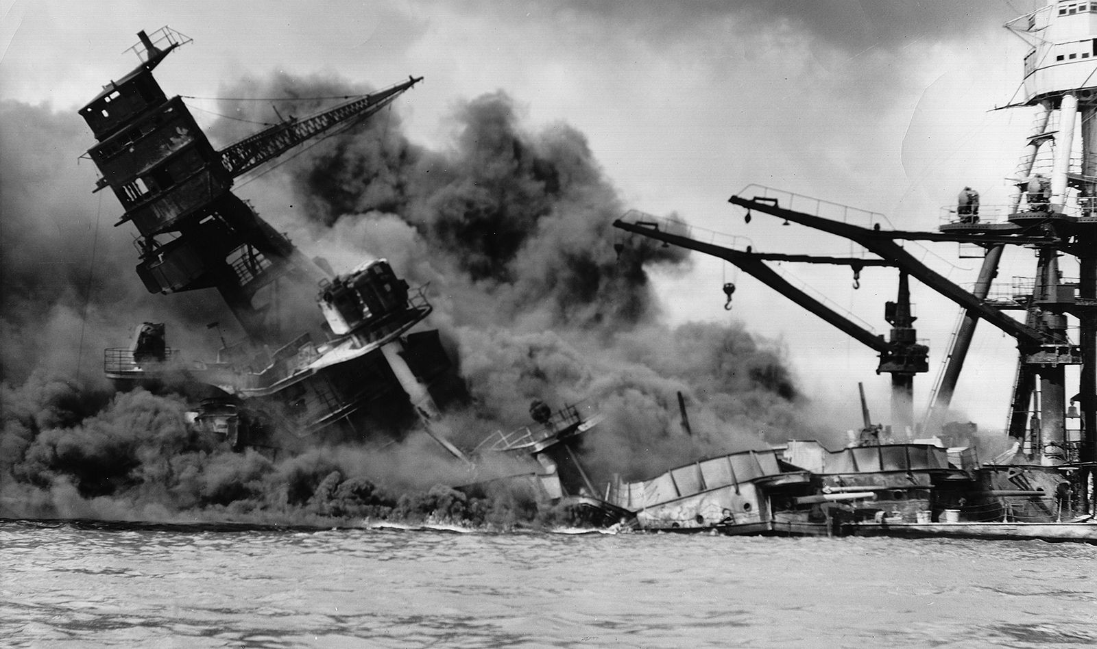

Slide 55
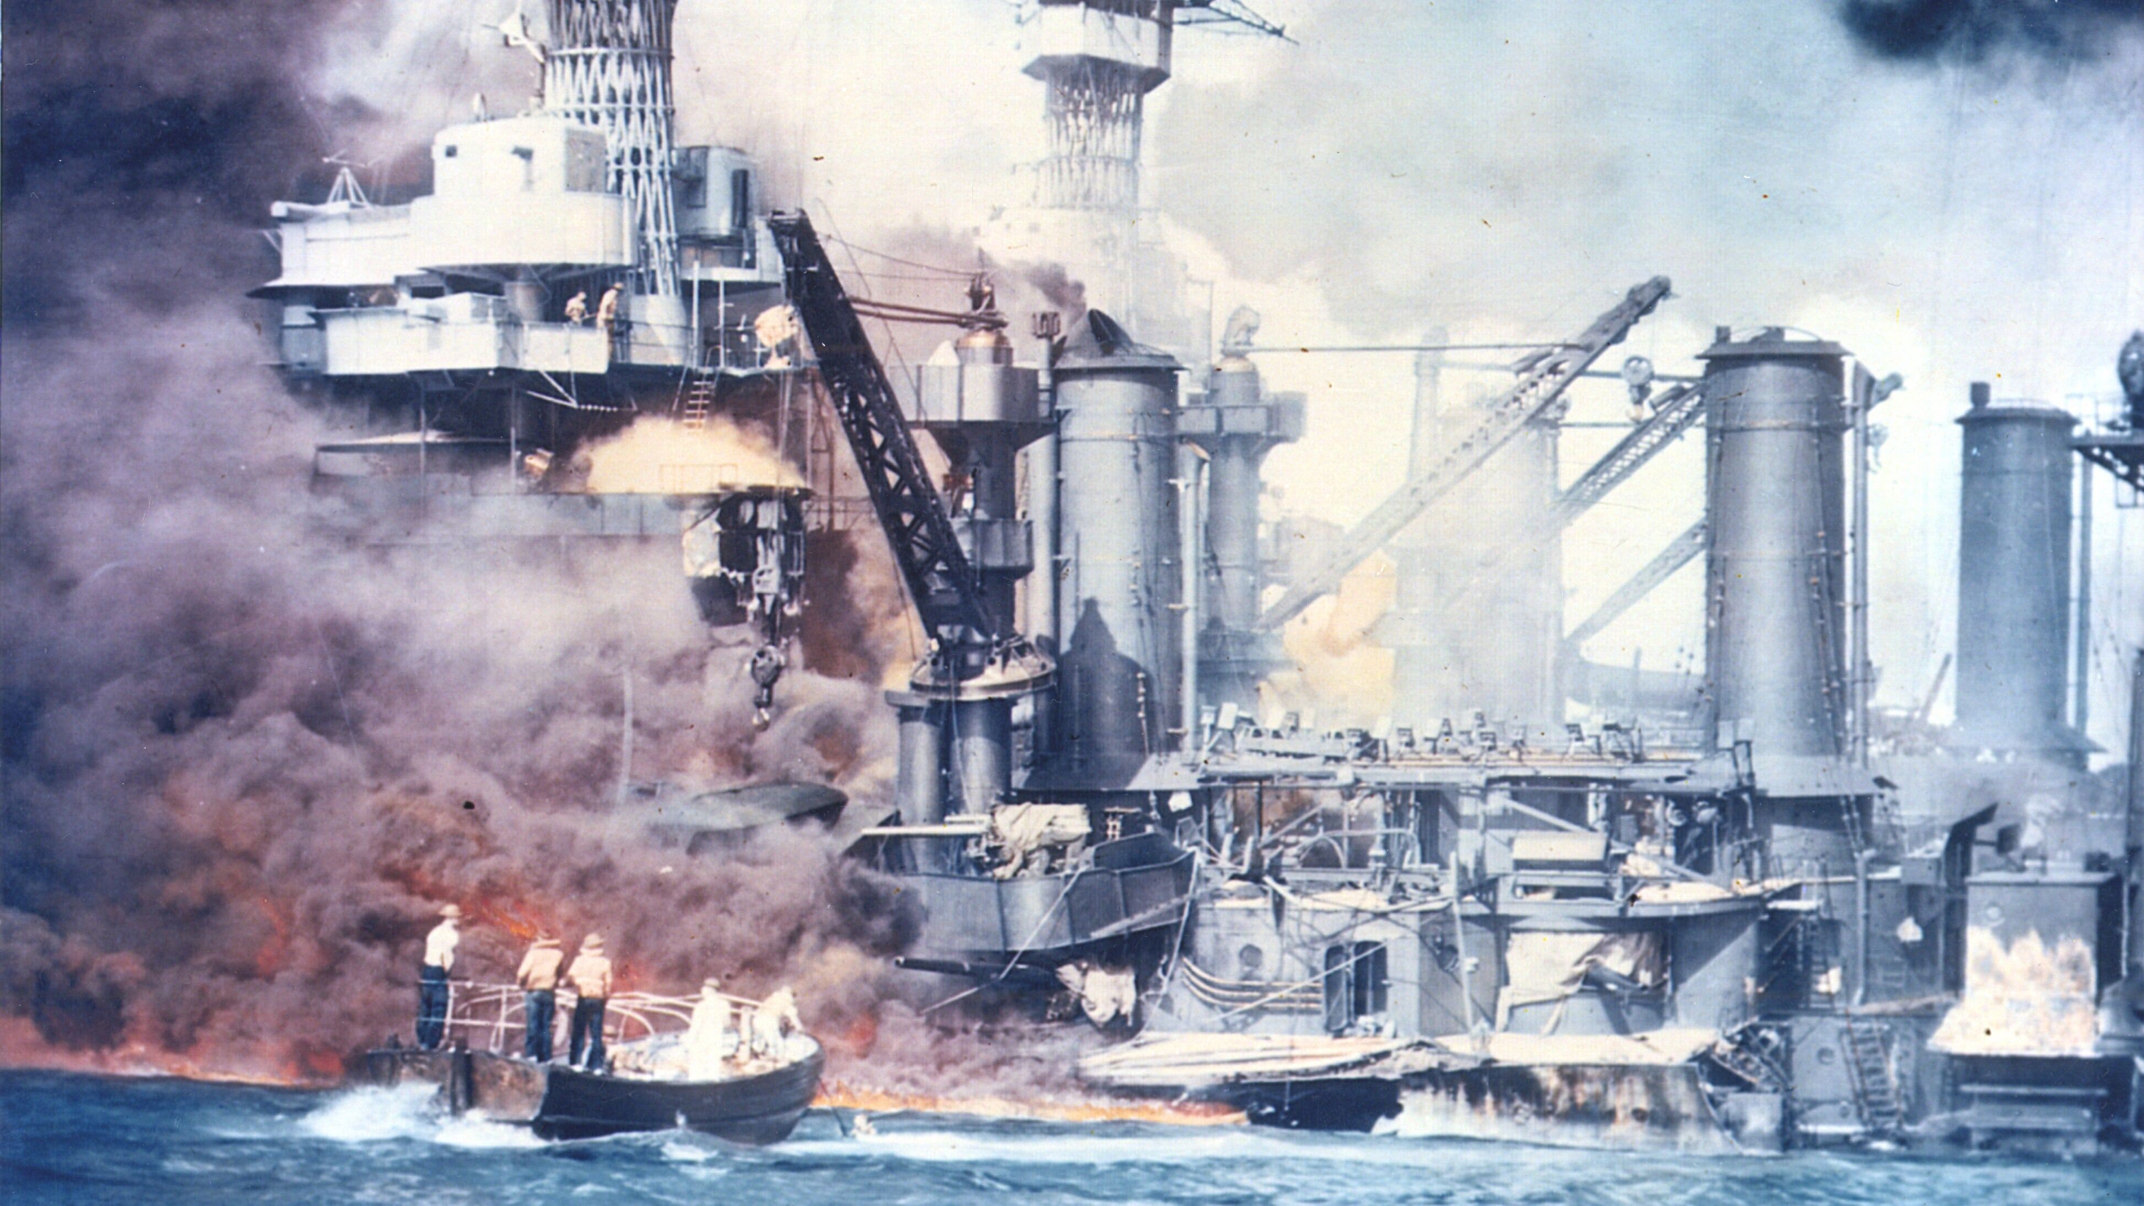

Slide 56
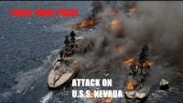

Slide 57
European theater
The United States was the main supplier of the Allies
Convoys needed to cross the Atlantic to transport goods
German Submarines and aircraft
Took days for convoy to reach Europe
Landing troops off the coast of France and Italy
Heading inland using road networks.

Slide 58
Invasion of Normandy
D- Day
Allied advance to reclaim Europe
Operation overload
Nazis are occupying France
Largest seaborne invasion in History
Allies tricked Germans into thinking they’d attack a different part of the coast.
U.S and France will maintain the beach head move towards Germany

Slide 59

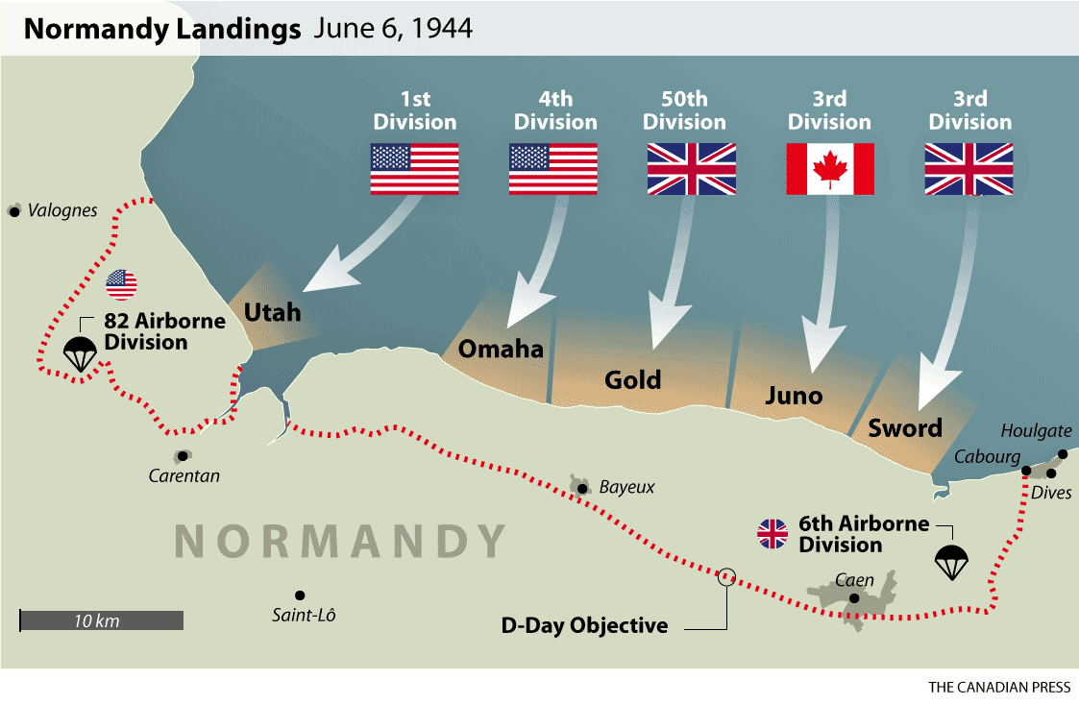

Slide 60
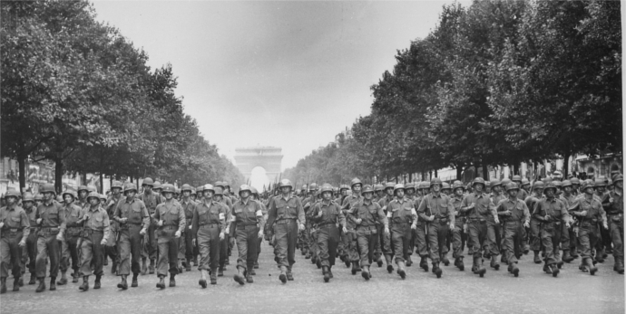

Slide 61
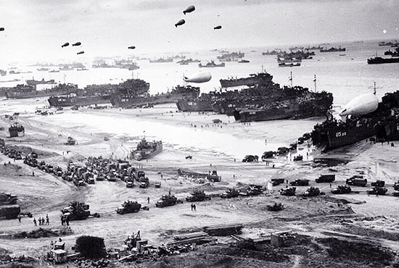

Slide 62
Battle of berlin
One of the final battles of the European Theater during World War II
Soviet Union enter Berlin (April 25, 1945)
87,000 Soviets killed; 458,000 Germans killed
Bloodiest battle of the war.
Adolf Hitler committed suicide
Fighting stopped in Berlin- May 2, 1945
V-E day- German surrendered

Slide 63
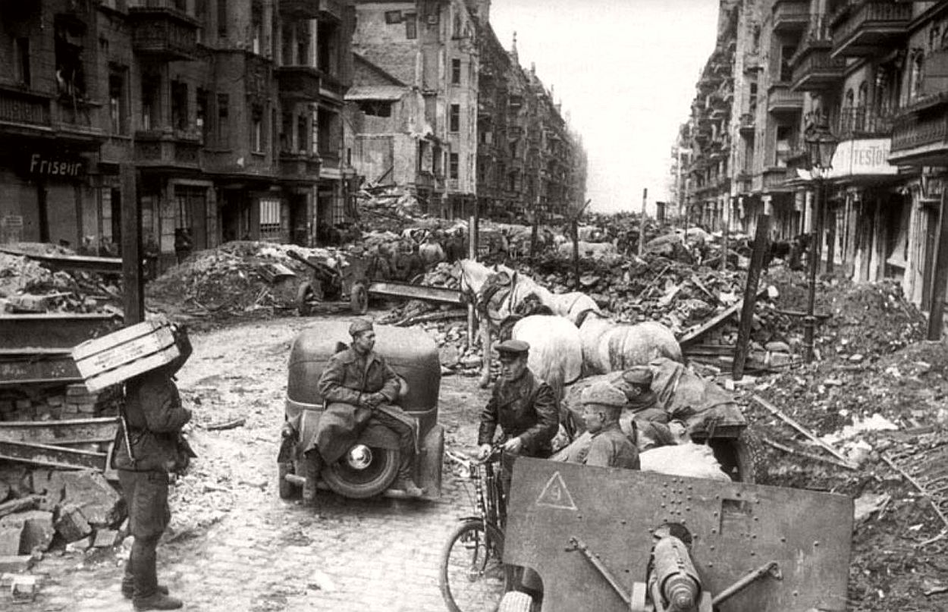

Slide 64


Slide 65


Slide 66
Pacific theater
Americans fought in both the Pacific and Europe
Pacific was three times the distance between New York and Great Britain
Little or no infrastructure to transport
Climate is difficult/ food supplies spoiled
Island hopping across the Islands serve as landing strips
Allow air bombardments of Japanese fortifications
Unique challenges came with U.S. delivering food and medical supplies

Slide 67


Slide 68


Slide 69


Slide 70


Slide 71


Slide 72



Battle of midway
Most important naval campaign of the war
U.S destroyed four Japanese air carriers
Japanese never recovered
U.S gain control of Pacific Islands
June 7, 1942

Slide 73
Manhattan project
Harry Truman becomes president in 1945
Responsible for making decisions regarding conduct of the war.
Atomic weapon or Military invasion of Japan’s mainland
Manhattan project- codename for research for developing an atomic weapon
July 16, 1945—successfully exploded flash seen 180 miles
Only nation with this weapon

Slide 74
Was it worth it?
Had been using aerial firebombing
  Night of March 9-10—launched a raid that killed 88,000-130,000 Japanese citizens in and around Tokyo—still no surrender
Realized we would need to invade to win
  Cost millions of lives
Russia quickly moving
  Possible post-war split Japan
Must act quickly
Truman decides

Slide 75


Slide 76

Atomic bomb
Warn Japan to surrender
August 6, 1945
  Hiroshima—“Little Boy”
  Japan still refuses
August 9, 1945
  Nagasaki—“Fat Man”
Emperor Hirohito’s horrified
  August 14—gives up
    V-J Day
Formal surrender =Sep. 2, 1945

Slide 77


Slide 78


Slide 79


Slide 80


Slide 81


Slide 82
Battle of Los Angeles
February 1942
Naval intelligence advise California to steel themselves from a Japanese Attack
A Japanese submarine surface off the coast of Santa Barbara, Ca fires shots at an oil refinery.
Military Radar picked up that enemy contact was approaching Los Angeles
Troops’ manned aircraft guns and searchlights were pointing at the skies
An unidentified object was discovered, and troops began to fire.
No injuries or plane crashes.

Slide 83


Slide 84

Domestic impact during ww2
The Roosevelt administration created the War Production Board
The War Production Board is responsible for allocating materials and fuel
Halt on nonessential goods. (automobiles)
Civilian industrial plants produce war goods in great quantities.
Automobile manufacturers produced great numbers of military vehicles and aircraft.
Food rationing was encouraged- sugar, meat, butter, and fruits required coupons.
Planted Victory Gardens

Slide 85

Women found jobs
216,000 serve in the Arm forces
U.S government campaign to lure women into the workforce
“Rosie the Riveter”
Pilots, factories, nurses, etc.
Enjoy economic independence
By the end of the war 18 million women entered the workforce.

Slide 86


Slide 87


Slide 88

A. Phillip Randolph
Black workers were denied defense jobs
Believe blacks could not be trained for complex mechanic jobs for aircraft construction.
Created the Brotherhood of Sleeping Car Porters to fight discrimination.
Met Roosevelt in Sept. 1940
Urging to end discrimination practices with gov. contracts
Decline request

Slide 89

March on washington
Randolph March on Washington started Jan 1941.
Roosevelt feared race riots might occur
Roosevelt issued an executive order to prohibit discrimination on gov. contract jobs.
March was cancelled

Slide 90

Internment
The U.S. worried that the large immigrant population might serve as a security risk.
Too many Italians and German immigrants.
Believe the Japanese Americans were loyal to Japan.
Force into internment camps.
Many Japanese Americans were removed from the west coast states
Internment camps were in the desert regions.
Released early 1945

Slide 91


Slide 92


